Slide 1

GUVI CAPSTONE PROJECT
Crafting Compelling Web Presences MBM6
Presented By:
Laksmi Priya m

Slide 2

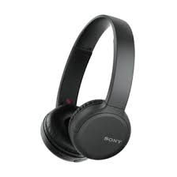
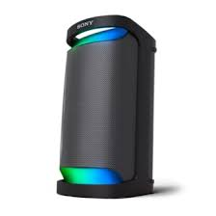
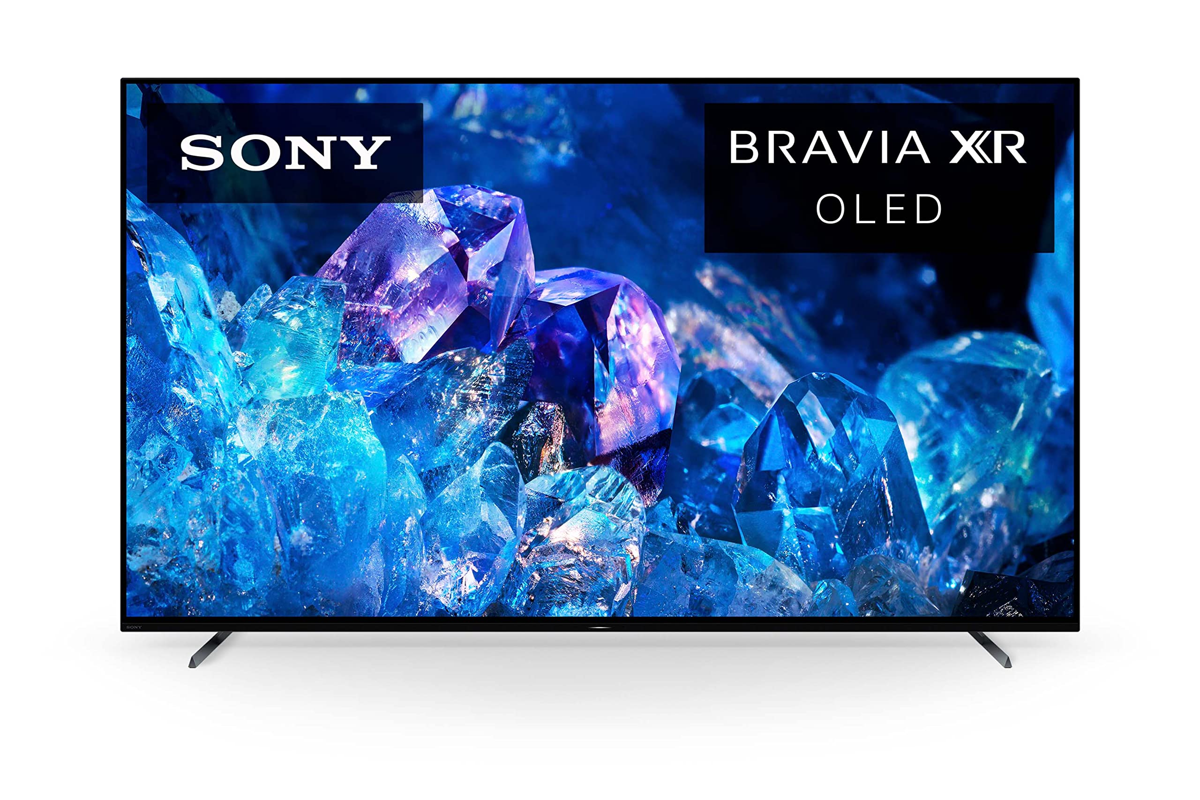
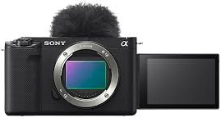
PRODUCTS TO BE COVERED
Sony TV
Headphones
Interchangeable lens Camera
Wireless Speaker

Slide 3
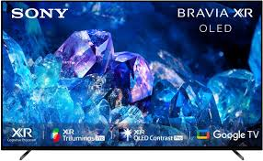
SONY TV
Description:
The Television is powered by XR processor to make it as real visual for the Audience.
XR OLED Intelligent motion processing for smooth, fast-moving action and picture quality is upscaled to 4K.
XR OLED is adaptive calibrated mode, works based on the show to room lighting conditions.
Bravia Core calibrated mode including iMAX enchanced and adjustments of title to the picture to experience movie from home.
Game Features: Screen image simulated, atmospheric sound, Auto HDR tone Mapping, Genre Picture Mode.
Eco: Optimising brightness and power consumption, eco settings in one place.
The design is beautiful made durable with less virgin plastic.
Sound: The sound is from center of the screen perfectly matching the scene rather than beneath the screen like conventional TV.
Voice Zoom2 detects voice, analyses them and improves the clarity.

Slide 4
SONY TV
Smart features: Connect to different apps, control the Tv with voice assistant , Cast image , video from phone to Tv easily.
Added advantage Compatible with Apple AirPlay and Siri to control your TV with the voice assistant.
Add-ons: Kids profile helps to guide the kids with age appropriate shows , game and other contents.
BRAVIA CAM
Proximity alert when kids or adults gets closer to the TV, Video call with family and friends when we pair with camera. Attaching and detaching BRAVIA CAM is so easy just with one swipe.
DESIGN
The stand is stylish , aluminium slim wedged stand with a diamond shaped cross section makes it even thinner.
The one slate design minimises noise and maximises the experiences
The metal flush surface makes our eyes to focus on the screen rather than the outer surface.

Slide 5

HEADPHONES
DESCRIPTION:
Battery life is up to 35 hours. Quick charge for 3 minutes will give extra 60 minutes of charge.
The integrated Processor V1 provides authentic experience with minimal distortion.
The Digital Sound Enhancement Engine (DSEE)restores to produce high-quality sound that’s closer to original recording.
Multipoint connection.
Buttons located help to play, stop and adjust the volume.
Hands-free help through voice assistant.
Effortless Bluetooth pairing.
Beamforming microphones with precise voice pickup
Technology.
Noise cancelling headphones with newly noise reduction
structure.

Slide 6
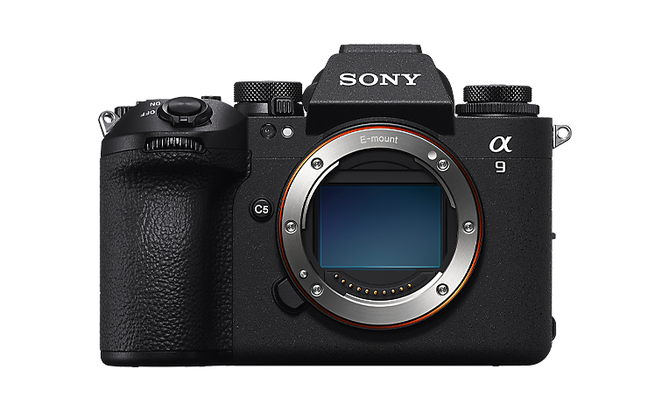
Interchangeable lens Camera
DESCRIPTION:
Camera Sensor Type 35mm full frame RS CMOS sensor
Number of pixels approximately 25.2 megapixels.
Image sensor is Anti-Dust system.
Movie functions is slow and quick motion.
Recording system has 2 slots of memory card.
Focus system type is Fast Hybrid AF (phase-detection AF / contrast-detection AF).
FOCUS POINT Still images: Max. 759 points (phase-detection AF), Movies: Max. 627 points (phase-detection AF)
SHUTTER SPEED Still images: 1/80000 to 30 s, Bulb, Movies: 1/8000 to 1 s and it is an Electronic shutter.

Slide 7
Image stabilization is there and Image sensor-shift mechanism with five-axis compensation (compensation depends on lens specifications), Advanced optical 5-axis image stabilisation.
Bluetooth connection and wireless LAN is available.
USB streaming in video data format MJPEG, YUV420.
Image processing engine - BIONZ XR

Slide 8
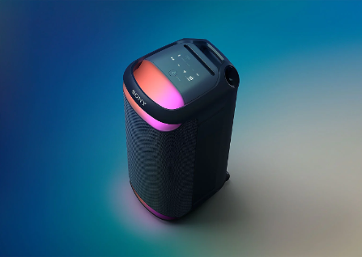
Wireless Speaker
Description:
High quality sound.
Battery life is 25 hours and with 10 minutes of quick charge gives 3 hours of playing time.
Connect Speaker to TV with optical cable.
A powerful combination of TV sound two rear tweeters and dual X-Balanced Speaker Units will provide you with an upgraded TV sound.
Connect with up to 100 compatible speakers and sync your music and lights.
Discoverable for your Android devices as soon as you turn it on.
USB Play, and charge devices.

Slide 9

Determine the platform on which the website is developed
Used online tool - wappalyzer

Slide 10
Technology Stack Sony.co.in
CMS- Adobe Experience Manager
Programming Language – Java
Video players – Flowplayer
Youtube
UI frameworks – Bootstrap
Web servers – Apache HTTP Server
JavaScript frameworks – RequireJS
React
Widgets – Outbrain
JavaScript libraries – core-js , crypto-js, jQuery, Hammer.js, Lodash, Modernizr, Swiper

Slide 11
Tag Managers – Tealium
Security – HSTS, Akamai Bot Manager
Reviews – Bazaarvoice Reviews
Digital asset management – Adobe
Dynamic
Media
Classic
Customer data platform – Tealium
Adobe experience platform identity service
Treasure data
Cookie compliance – Tealium consent management
CDN – Akamai
cdnjs
Cloudflare
Analytics – Adobe Analytics , Google Ads Conversion Tracking, Facebook Pixel, Google Analytics
Miscellaneous – Open Graph, Babel, HTTP/2

Slide 12
Test the website's responsive design and mobile optimization.
TOOLS USED
PageSpeed Insights (PSI) reports on the user experience of a page on both mobile and desktop devices, and provides suggestions on how that page may be improved. PSI provides both lab and field data about a page. Lab data is useful for debugging issues, as it is collected in a controlled environment.
Viewport Resizer:
Responsive Design Testing Google chrome extension.

Slide 13
Pages we are going to Test
Home Page
Product Page
Shopping Cart
Register Page

Slide 14
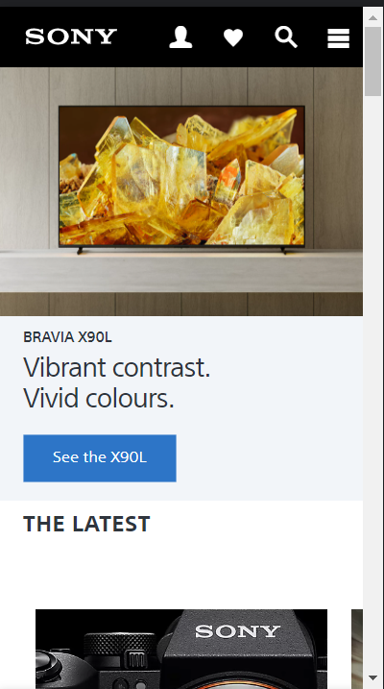
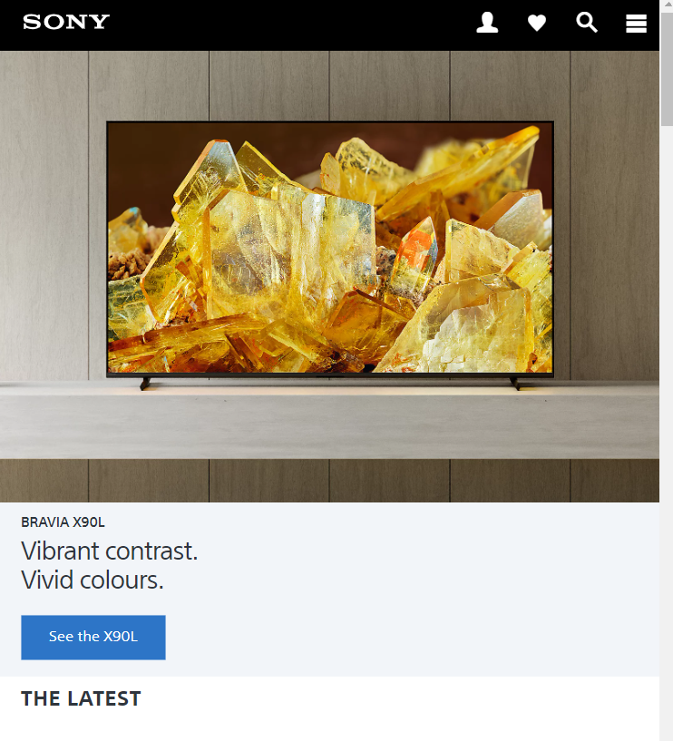
Home Page
iPhone 5/SE Size: 320x568 Tablet

Slide 15
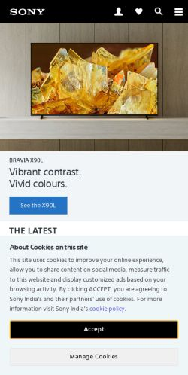
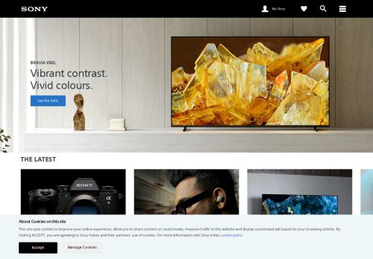
Mobile
Desktop

Slide 16
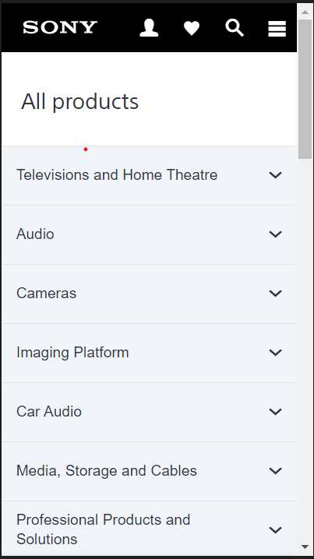
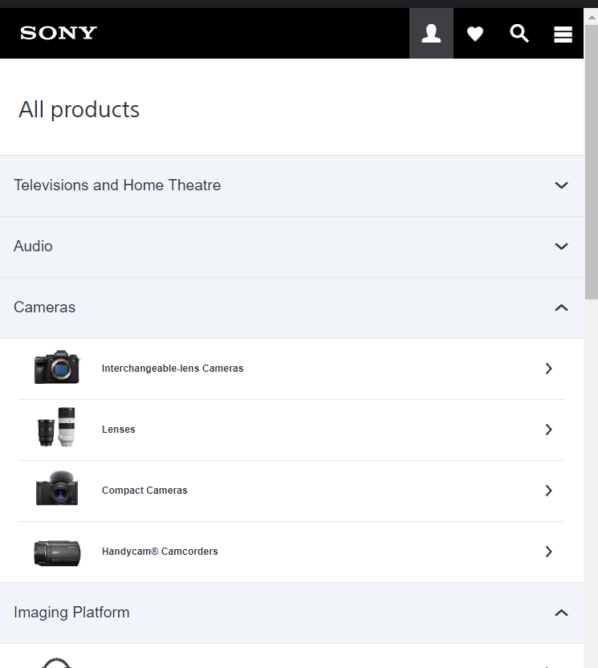
PRODUCT PAGE
Iphone
Tablet

Slide 17
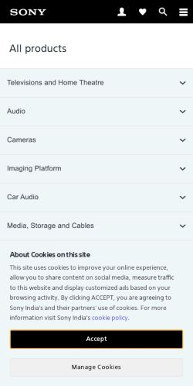
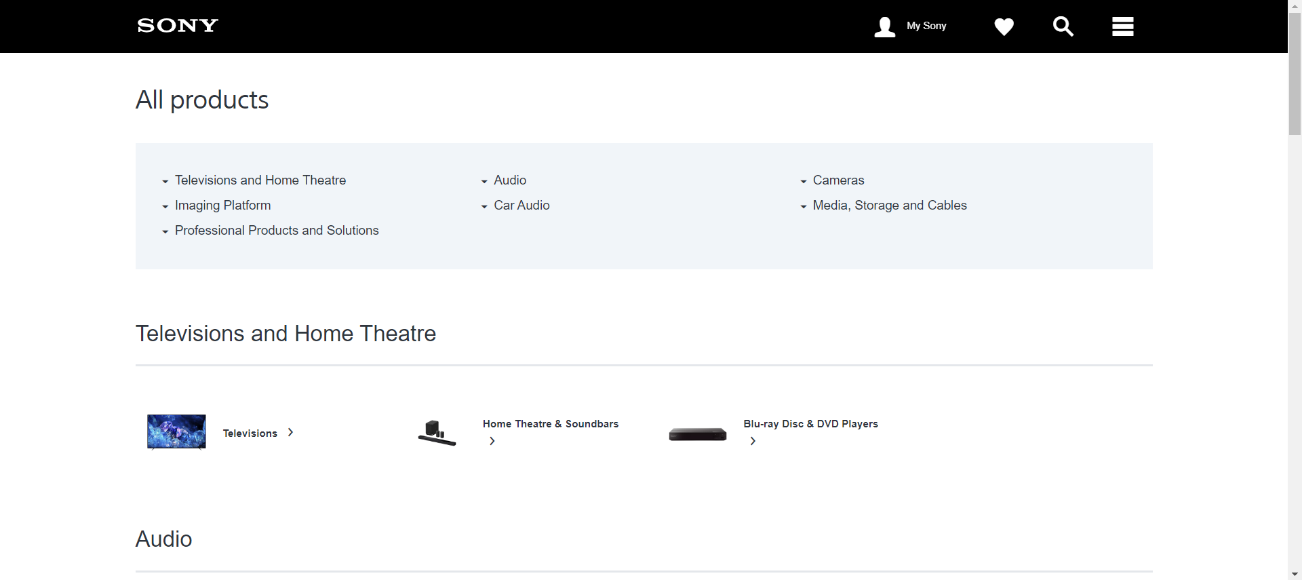
Mobile
Desktop

Slide 18
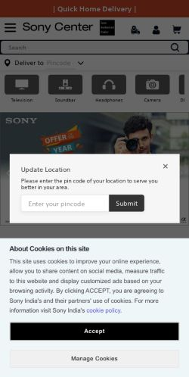
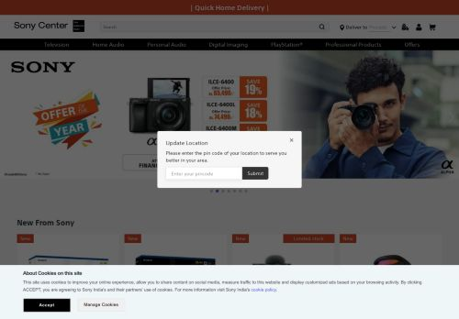
SHOPPING CART
Mobile
Desktop

Slide 19
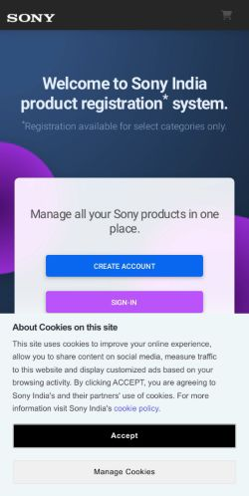
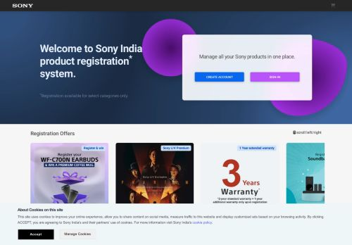
Register Page
Mobile
Desktop

Slide 20
Identify common website design mistakes to avoid, such as cluttered layouts and slow loading times(List at least 5 suggestions)

Slide 21
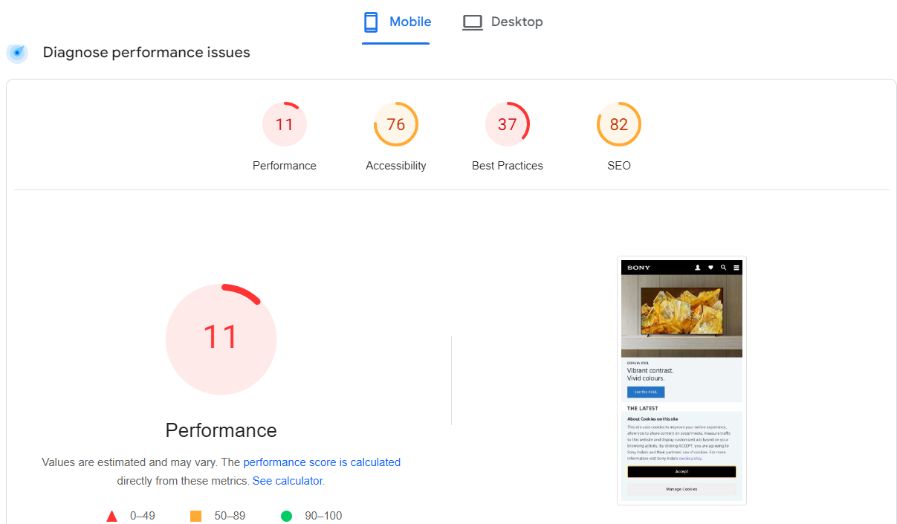
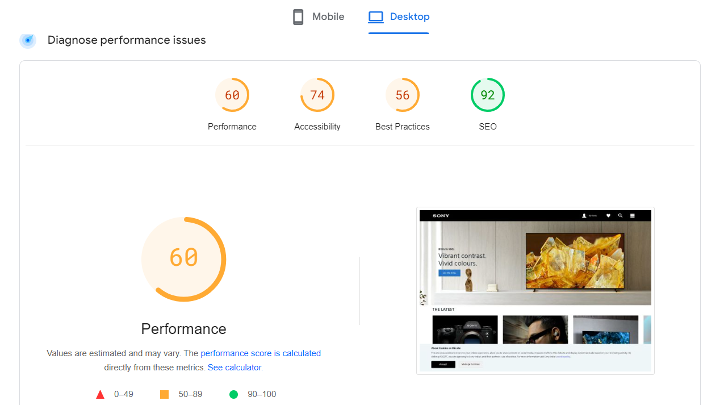
1. Performance Issue
Avoid large layout shifts: The largest layout shifts observed on the page. Each table item represented in a single layout shift, and show the element that shifted the most. Each item metioned would be possible root cause that led to the layout shift. Some of these layout shifts may not be included in the CLS metric value due to windowing.
Solution: Specifying image dimensions by always specifying, both, width and height for your website's image and video elements so that the correct spacing is used for images/videos. Alternatively, you can use CSS aspect ratio boxes to do the same.

Slide 22
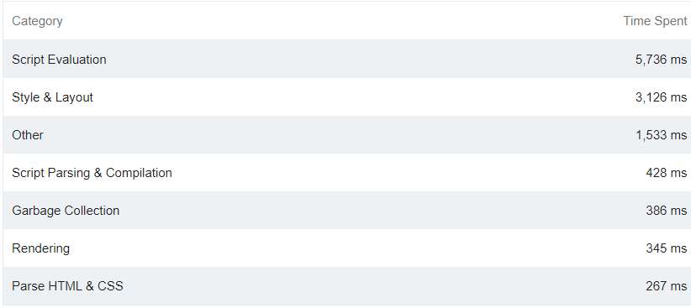
2. Minimize main-thread work
Solution:
Consider reducing the time spent parsing, compiling and executing JS. You may find delivering smaller JS payloads helps with this.

Slide 23
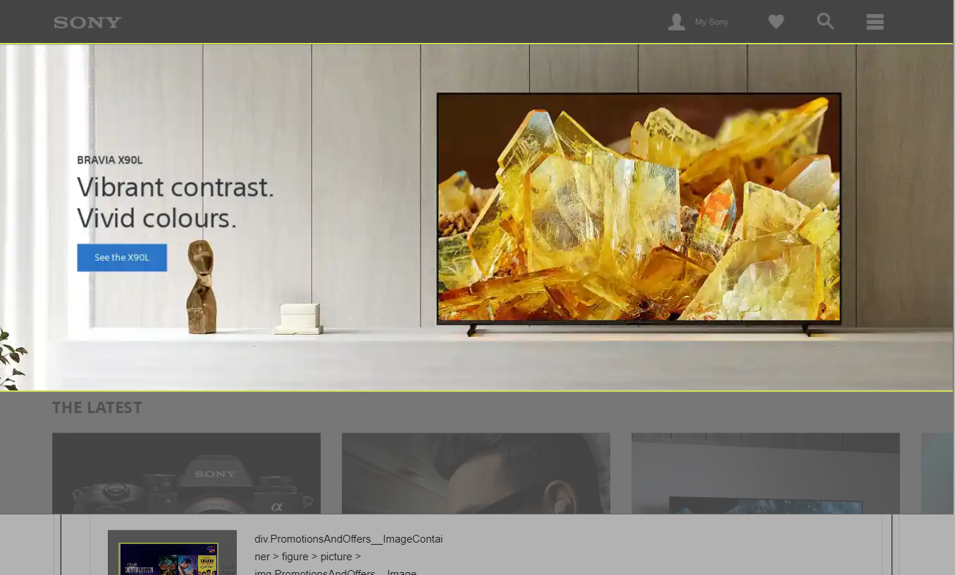
3. Properly size images
Solution:
Serve images that are appropriately-sized to save cellular data and improve load time.

Slide 24
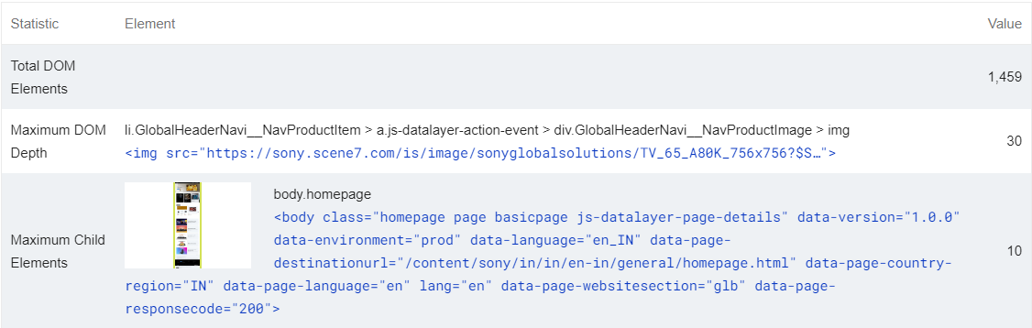
4. Avoid an excessive DOM(Document Object Model) size
Solution:
A large DOM will increase memory usage, cause longer style calculations, and produce costly layout reflows.

Slide 25
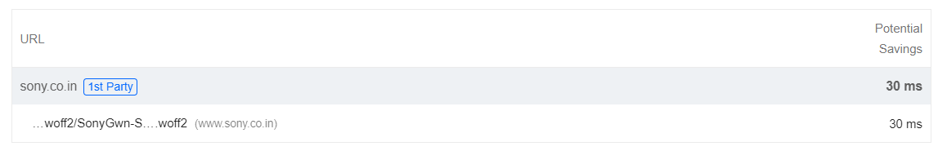
5. Ensure text remains visible during webfont load
Solution:
Leverage the font-display CSS feature to ensure text is user-visible while webfonts are loading

Slide 26
Provide a list of best practices for creating visually appealing and user-friendly websites designs

Slide 27
1. Accessibility:
The aim of the web accessibility is to make a website user-friendly, understandable, operable and robust.
2. Responsivity:
Responsive design means investing in a highly flexible website structure. On a responsive site, content is automatically resized and reshuffled to fit the dimensions of whichever device a visitor happens to be using. This can be accomplished with mobile-friendly HTML templates, or by creating a special mobile site.
3. Navigation:
Navigation is an essential element of a user-friendly website. Use a clear navigation menu that is easy to understand and navigate. Organize the content into categories and ensure that each category is easily accessible from the navigation menu.
4. Fast Load Times:
A website with slow load times can be frustrating for users and can lead to high bounce rates. Ensure that your website has fast load times by optimizing images, compressing files, and minimizing HTTP requests. Test your website’s load times regularly to ensure it is performing at its best.

Slide 28
5. Use high-quality Images:
High-quality images can help make your website more visually appealing and engaging. Use high-quality images that are relevant to your content and help tell your brand’s story. Optimize your images for web use to ensure fast load times.
6. CTAs(Call-To-Action):
There should be multiple CTA’s in different landing page based on their use and guide the user with relevant information.
7. Text minimization:
Large chunks of text in a web page makes unattractive, user would not like to read a lot of words. They just want the minimum information in their search.
8. Place important information at top:
People prefer to know the main crisp of the content as soon as they land in the page. So, it is better to give information quick and efficiently as possible.

Slide 29
Design a landing page for their product or service to generate leads.(Use Mockup or Figma or Any other tools to show the design)

Slide 30

Tool Used

Slide 31
Landing Page

Slide 32
THANK YOU

